Slide 1


SAP UI5 & FIORI with OData TRAINING using BAS
Anubhav Oberoy
Day – 6

Slide 2

Agenda – Day 6
How the UI5 framework Works
Hook Methods of the Controller
Basics of OOPS
Concept of Control Hierarchy
Basics of Control Hierarchy
Models in SAP UI5
Model Basics
Steps to Create a Model
Data Binding
Types of Data Binding Syntax
Types of Binding
Modularization of model
Binding Modes.

Slide 3
How UI5 Framework works
Browser
CDN
SAP UI5 Framework
View
(Main.view.xml)
controllerName=“…”
Call the controller Name
1
Index.html
3
The framework starts to find the controller with the same name
It will return controller name to the framework
var oView = new sap.ui.view({
viewName: “mickey.view.Main",
type: “XML“
});
2
Loads the view
The object of the controller get all the controls .
6
8
Renderer
7
The view returns all the controls to the renderer
Controller
(Main.controller.js)
onInit() function
The renderer converts it into browser friendly language
Create the controller object
HTML + CSS
4
Call the constructor of controller
Get the object of the controller
5

Slide 4
Hook Method of Controller
onInit()
onBeforeRendering()
It is a function which gets called immediately after UI5 creates the object of our controller. It is like constructure of a class. We can use this to initialize our class variable
It is a method which gets called MULTIPLE times, Before every time the view is displayed to the user. We can use this method for pre-processing on a view.
IN
BR
EX
AR
onExit()
onAfterRendering()
It is a function which gets called before the instance of our controller gets destroyed. It is like destructor of a class.
We can use this to write clean-up code.
It is a method which gets called MULTIPLE times, After every time the view is displayed to the user. This method can be used to show effects to the user.

Slide 5

Basic of OOPS
A relation between 2 classes which are not of same family is called association
Aggregation – lose coupling, both objects can function independently, should have relationship
Composition – tight coupling, both objects must CO-exist, must have relationship, they cannot function independently
Passenger
+passportno, +name, +nationality +isfamily
Drive(), check-in(), securitycheck()
0..*
Aggregation
Airplane
+height +width +color
Fly(), land(), load()
Airplane
+height +width +color
Fly(), land(), load()
Wings
+height +company +size
Rudder() alerons()
1..*
Composition
Passenger plane
+No_of_seats
Bording()
Passenger plane
+No_of_seats
Bording()
Cargo plane
+Cargo_space
Loading()

Slide 6
Concept of Control Hierarchy
Concept of control Hierarchy tells us about how the SAP UI5 Controls are structure on the basis of the object oriented Paradigm.
Note:- Whenever we see a control, and if we are unable to find a property, association, event or function in that class, check its parent class.
sap.ui.base.ManagedObject
sap.ui.core.Element
sap.ui.core.Control
sap.m.Button
sap.m.InputBase
sap.ui.view
sap.m.Table
sap.ui.layout.form
sap.m.Input
sap.m.Column
SimpleForm
Some Frequently used Controls

Slide 7
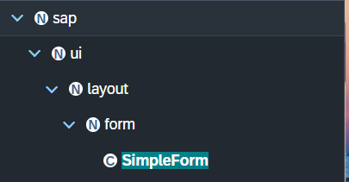
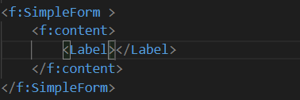
Basics of control hierarchy
To use any control , first we have to include controls’ parent class into the view
for example: To use the SimpleForm we have to include its parent class which
is sap.ui.layout.form
The namespace have to given to the parent class
xmlns:f=“sap.ui.layout.form”
When we use the aggregation of any control same namespace will follow by the
the aggregation as parent.
The control name must start with capital letter and the aggregation name starts with small letter.
We have to check which control will aggregate to the control itself, if the aggregate control is the Control class or element class we can pass any of their child class to the aggregation.
for example:
As the <f:content> extend the element class we can use the <Label> which is also child of element class inside the <f:content>

Slide 8
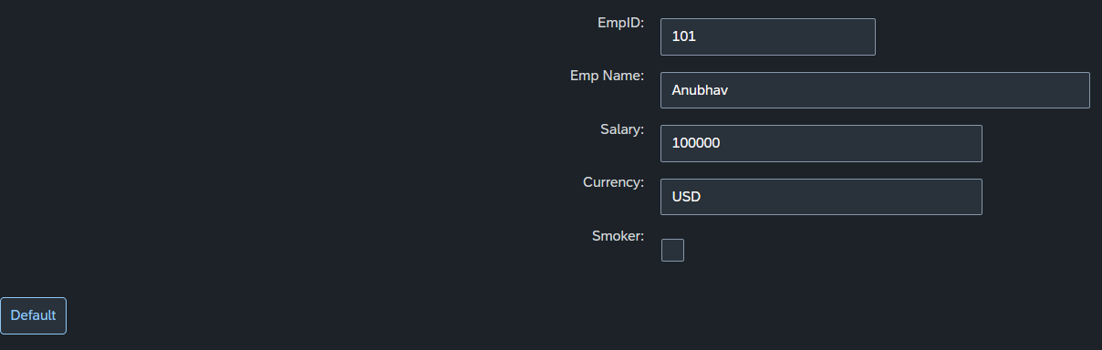
Hands-on :
Create a SimpleForm Using the Control Hierarchy discussed in previous Slide.
Create a Button on press of that button the value of the Employee Id in the simple Form .
Code Link :
Main.view.xml
Main.controller.js

Slide 9
Models in SAP UI5
Models are the Object of the data. It contains all the data related to the application .
The various model types supported by SAPUI5 are:
OData model
JSON model
XML model
Resource model
Each model in SAPUI5 is mainly used to bind controls to the data brought in. The JSON model is a client-side model which is recommended for datasets with small amounts of data.
Server Side Model
These three are the Client side model
%
Usage of Models:
100
100
100
95
80
Usage in Percentage
60
40
40
20
Models
OData
JSON
XML
Resource

Slide 10
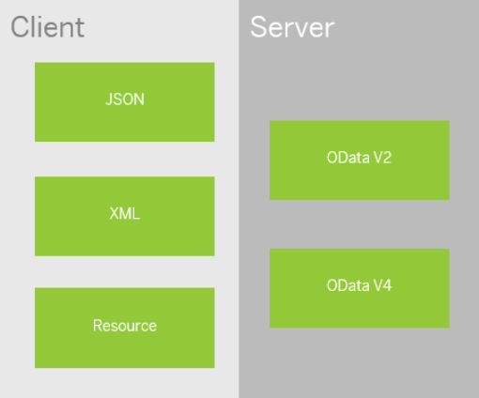
Model Basics
All the models in SAP UI5 are characterized in two different parts:
Client-Side Model: -
A model which keeps all the data in the browser. We use client-side model for manipulating data (like internal table).
Server-Side Model: -
Keeps data on server side, and ON-demand, it is loaded by client using the server-side model.
We can use the APIs (Methods) provided by SAP to access data from model
We need to get model object using methods
getModel(modelName)
setModel(modelName)
From model object we get access to the data using methods
setProperty(sPath, sValue)
getProperty(sPath)

Slide 11
Steps to Create a Model
4 Easy Steps to Create a Model
Step 1: Create a brand-new object of the Model
To Create JSON Model - var oModel = new sap.ui.model.json.JSONModel()
To create XML model – var oModel = new sap.ui.model.xml.XMLModel()
To create Resource model – var oModel = new sap.ui.model.resource.ResourceModel()
To create OData Model – var oModel = new sap.ui.model.odata.v2.ODataModel()
Step 2: Set or Load the data in the Model
oModel.setData({});
oModel.loadData(filePath);
Step 3: Make the model aware to the application/view
sap.ui.getCore().setModel(oModel);
this.getView().setModel(oModel);
this.getView().byId(“controId”).setModel(oModel);
Step 3: Data Binding : It is the concept of mapping the Views and Model with which the UI knows where the data is into the model. This is done by calculating the path (address of the data).
Create object of the Model
Set/Load Data in Model
Set Model at View Level

Slide 12
Data Binding
Data binding is the process that establishes a connection between the application UI and business logic.
It is a bridge between a binding target(View) and a binding source(Model).
In the json data we can make address as “Every curly braces is converted to / and every array item is converted to /index”.
{"empStr": {
"empId": 0001,
"empName": "Anubhav",
"salary": 8000,
"currency": "USD"
},
"empTab": [{
"empId": 0009,
"empName": “Ananya",
"salary": 9500,
"currency": "USD“
}, {
"empId": 0010,
"empName": “Shwetha",
"salary": 10000,
"currency": “EUR"
}]}
Q: what is the salary of Anubhav
/empStr/salary
Q. What is the emp name of emp 0001
/empStr/empName
Q. What is the salary of Shwetha
/empTab/1/salary
Q. What is the empId of Ananya
/empTab/0/empId
This is the address of the data
To bind the data with the view we have to give the path of the data , so we have to use the curly braces as :
{/empStr/empName}
This is the path of the data

Slide 13
Types of Data Binding syntax
Binding using the path of the data
{/empStr/empId}
Binding as property specific method:
this.getView().byId(‘controlId’).bindValue(‘/empStr/empSalary’)
Binding as property generic method:
this.getView().byId(‘controlId’).bindProperty(‘value’ , ‘/empStr/empSalary’ )
Binding using the path expression , this is also know as complex binding syntax
{path : ‘/empStr/empId’}
this syntax is helpful when we use formatter .
this syntax will not work by default until we inform it to the SAPUI5, to make this syntax work we have to add a line
code inside the bootstrap code of the application.
data-sap-ui-bindingSyntax= “complex”
Name of the property with which we want to bind

Slide 14

Types of Binding
SAP UI5 have 4 types of Binding options:
Property Binding
Expression Binding
Aggregation Binding
Element Binding
Property Binding:-
When we bind property of a UI control, to the address of the model, this is called property binding. E.g., value property of Input control was connected to /emp/empId
All the four syntaxes we studied in previous slide are the example of property binding.
Ex:-
In XML view:-
<Text text=“{/emp/empId}” ></Text>
In controller: -
this.getView().byId(“controlId”).bindProperty(“text”, ‘/emp/empId’);

Slide 15
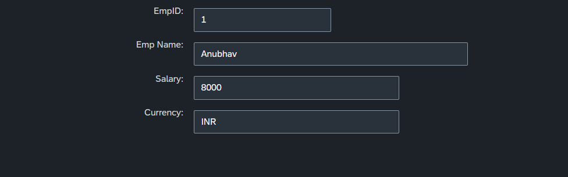
Hands-on:
Create a JSON model by following the steps explained in the previous Slides.
After Creating the Model bind the model to the SimpleForm using different binding Syntaxes.
Code link:
Main.view.xml
Main.controller.js

Slide 16
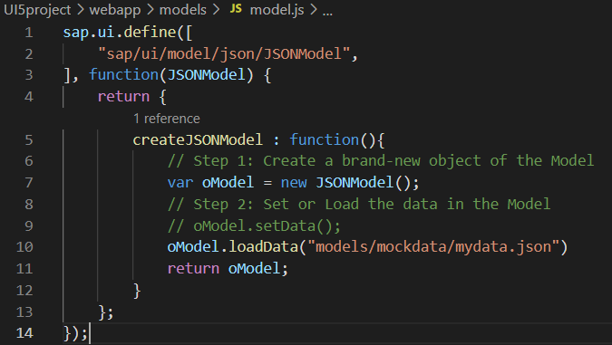
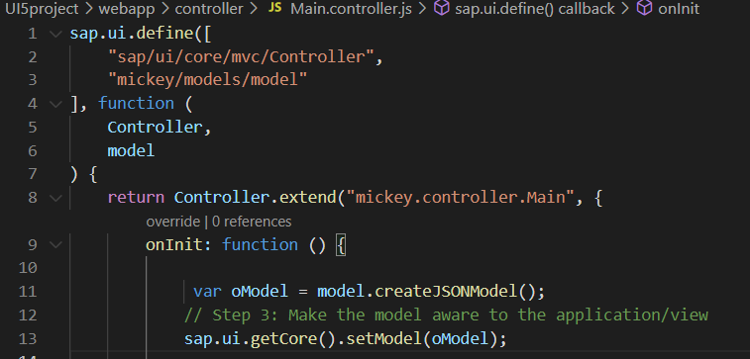
Modularization of Model
1. Create a folder in webapp with name models.
2. Inside models create a file name model.js and then create the function named createJSONModel: function(){}
3. Now create a folder inside the models named mockdata and then inside mockdata create a file named mydata.json
4. Inside the mydata.json put all the data in JSON format.
5. Then inside the models.js :-
6. Then call the model.js inside the controller and create the object then by using the object call the function of model.js
Loading the data from mydata.json using loadData() function
Call the model.js into the controller as dependency.
Object of the model.js
Call the createJSONModel function using the object

Slide 17
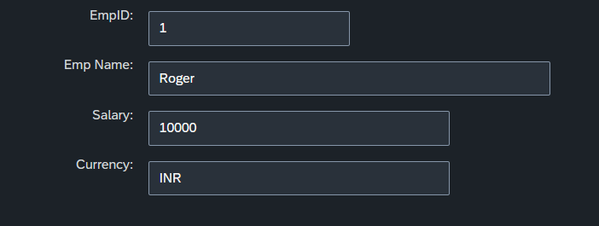
Hands-on: Modularize the Code
Modularize the code your project as per MVC Architecture by following the steps in the previous slide.
Code link:
Main.view.xml
Main.controller.js
mydata.json
model.js

Slide 18
Binding Modes
There are basically three modes of binding data in SAPUI5.
One-way binding – Here, the data is transported in one direction only, i.e., from the model, through the binding instance to the consumer (usually the property of a control), but never in the other direction. Any change done on the model data from the front end is not affected to the model. All the data changes are reflected only on the controls.
Two-way binding – Here all input changes done from front end controls are reflected on the model and the backend database. SAPUI5 automatically handles the transport of data both from the model to the controls and back from the controls to the model. It is the default binding mode.
One-time binding – Here all data will be bound from model to view just once. After that, the connection is no more set.
Data
Data
Model
View
Model
View
Data
One-way binding
Two-way binding
Data
Data
Data
Model
View
Model
View
One-Time binding

Slide 19

End of Day 6

Slide 20

Questions

Slide 21

Anubhav Oberoy

Slide 22


We’re committed to empower you to be
Most Desirable Resource
through powerful training solutions.
We build the workforce of the future.
250+
Corporate Clients
30,000+
Learners Trained
25000+
Learners Placed
FREE WEBINARS
Sign up for free webinars with industry experts every fortnight!
Enroll Now!
Contact us today!
https://anubhavtrainings.com/

Slide 23




More from AnubhavTrainings.com

Slide 24
Title
Content

